Slide 1
Computer Vision Fundamentals
Lecture 1 - Part 3
Basics of Image Processing

Slide 2
Contents
Image sharpening
Noise handling
Deblurring
Edge determination
Blurring
Function extraction
Pixeling

Slide 3
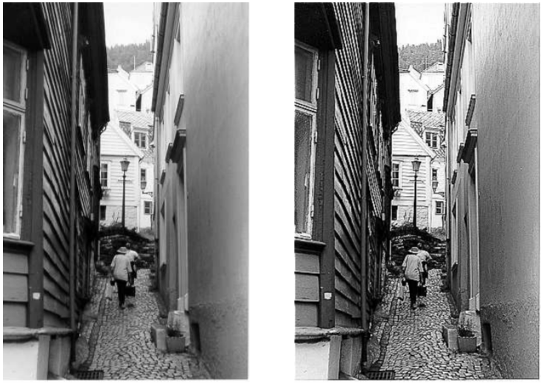
Image sharpening
Enhancing the edges of an image to make it appear sharper
Sharpening edges is a vital component of printing: in order for an image to appear “at its best” on the printed page; some sharpening is usually performed.

Slide 4
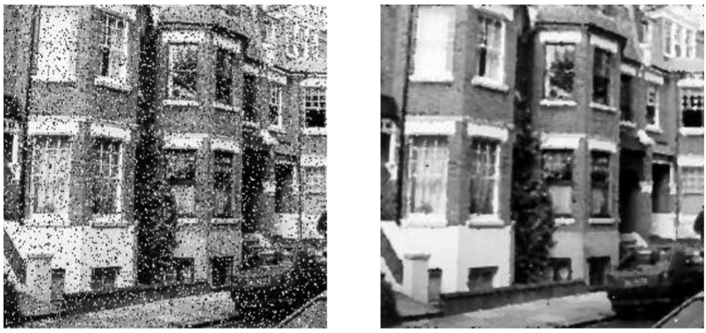
Noise handling
Removing “noise” from an image; noise being random errors in the image
Noise is a very common problem in data transmission: all sorts of electronic components may affect data passing through them, and the results may be undesirable

Slide 5
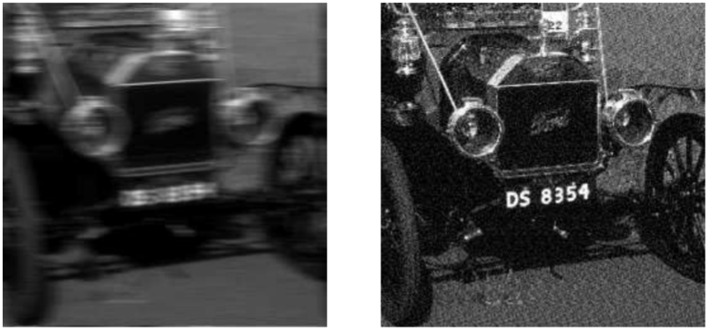
Deblurring
Removing motion blur from an image.
In photographs of fast moving objects: athletes, vehicles for example, the problem of blur may be considerable.

Slide 6
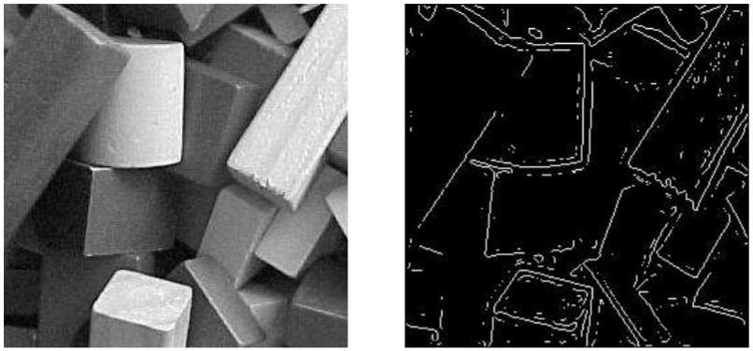
Edge determination
Obtaining the edges of an image
Once we have the edges we can measure their spread, and the area contained within them

Slide 7
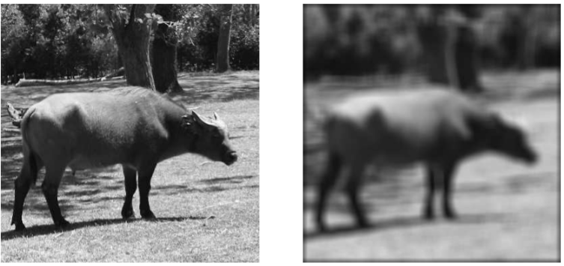
Blurring
Removing detail from an image.
For measurement or counting purposes, we may not be interested in all the detail in an image.

Slide 8
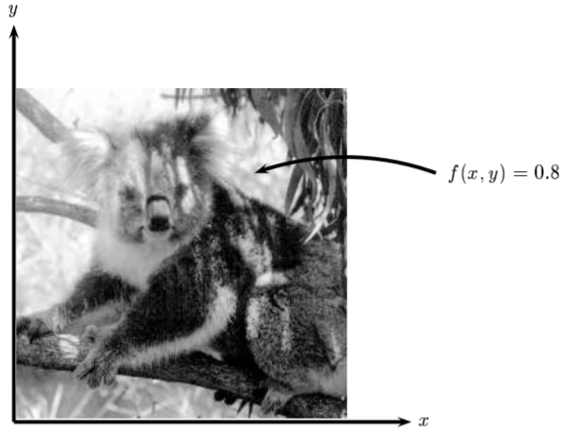
Function extraction
We may consider this image as being a two dimensional function, where the function values give the brightness of the image at any given point

Slide 9
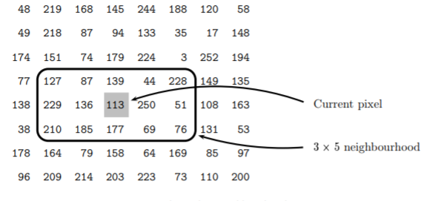
Pixeling
A digital image differs from a photo in that the x, y and f(x,y) values are all discrete
A neighborhood comprising of a matrix ‘right next’ to the pixel is established.

Slide 10
Thankyou

